Slide 1
Brand Detection Model using YOLO
Deep Learning Web Application with CNN
Technology Stack: TensorFlow, Flask, YOLOV8S, Google Cloud Run
Dataset: Chocolate Brand dataset

Slide 2
🎯 Objective
Deploy a production-ready web interface for real-time object detection in images.
Key Challenges
Real-time Processing: Detecting objects in upload image from web interface.
Model Accuracy: Trying to detect various brands of chocolates in different shapes.
Scalable Deployment: Deploy on cloud infrastructure for global access.
User Experience: Create intuitive, responsive web interface.
Key Features:
Web-based image upload interface with Real-time object detection.
Scalable cloud deployment.

Slide 3
Use Case & Business Value
1. Security & Surveillance
- Automated Monitoring system
- Intrusion Detection
- Crowd Analysis
2. Retail & Inventory
- Product Recognition
- Shelf Monitoring
3. Automotive & Transportation
- Traffic Monitoring
- Autonomous vehicle training
4. Healthcare & Research
- Medical Image analysis
- Laboratory Automation and Research data processing

Slide 4
Business Benefits:
Cost Reduction: Automated analysis vs manual inspection
Scalability: Cloud based infrastructure
Accuracy: State-of-Art YOLOV8S model
Integration: RESTful API for easy integration
Target Users:
Developers, researchers, businesses needing object detection APIs

Slide 5
System Architecture:
High-level Architecture
- Frontend (HTML/JS)
File Upload, Image Display, Results UI
- Backend (Flask)
YOLOV8S, Image Processing, API Endpoints
- Cloud (GCP)
Gloud Run, Auto Scaling, Load Balancer
Technology Components
- Frontend: HTML5, CSS3, JavaScript (Vanilla)
- Backend: Python Flask, Ultralytics YOLO
- Infrastructure: Docker, Gunicorn, Google Cloud Run
- Model: YOLOV8s (Small) - Balance of speed and accuracy

Slide 6
Logic Flow:
When app is up and running, in frontend web_interface.html will be loaded and in backend model will be loaded and kept ready for reference.
Once image is uploaded, it’ll be saved using secure_filename from werkzeug.utils
Then image will be sent to model for inference, resulting in Bounding Boxes, Confidence Score for it and Class Labels.
From the list of boxes, Non-Max suppression is used to remove overlapping boxes and Confidence threshold is used to remove low confidence detections.
For the final selected objects, rectangle box is drawn based on Coordinates and label will be prepared.
Then annotated image is converted to base64 format and sent to frontend as json.

Slide 7
Key Design patterns
Module Level Initialization
Lazy Loading fallback
Error handling using try and except
Deployment Strategy
Production Deployment (GCP Cloud Run)
# Container Build
docker build -t gcr.io/project/yolo-api .
# Deploy with Resources
gcloud run deploy --memory 6Gi --cpu 2

Slide 8
Infrastructure Benefits
Serverless: Scales to zero when unused
Auto-scaling: Handles traffic spikes
Global: Multi-region deployment
Cost-effective: Pay per request
Resource Allocation
Memory: 6GB (YOLOV8s requirements)
CPU: 2 cores (parallel processing)
Timeout: 900 seconds (large image processing)
Concurrency: 10 instances max

Slide 9
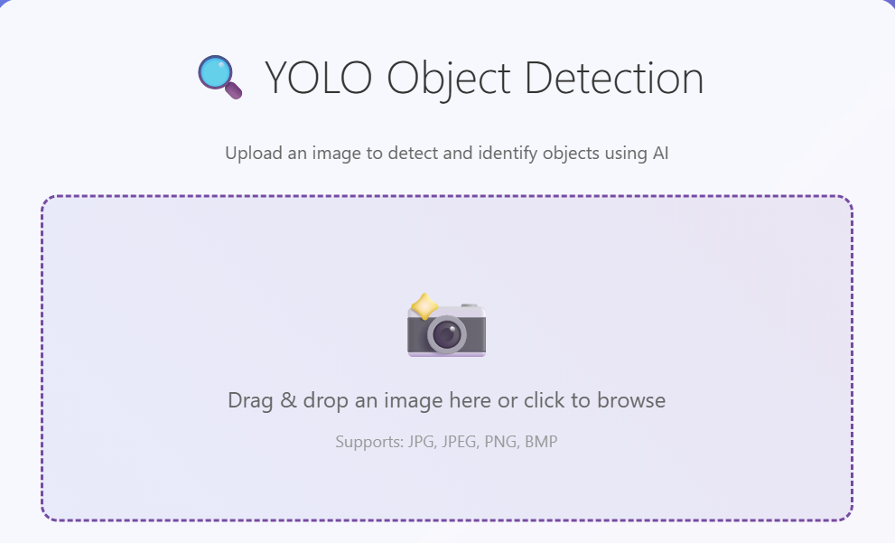

Slide 10
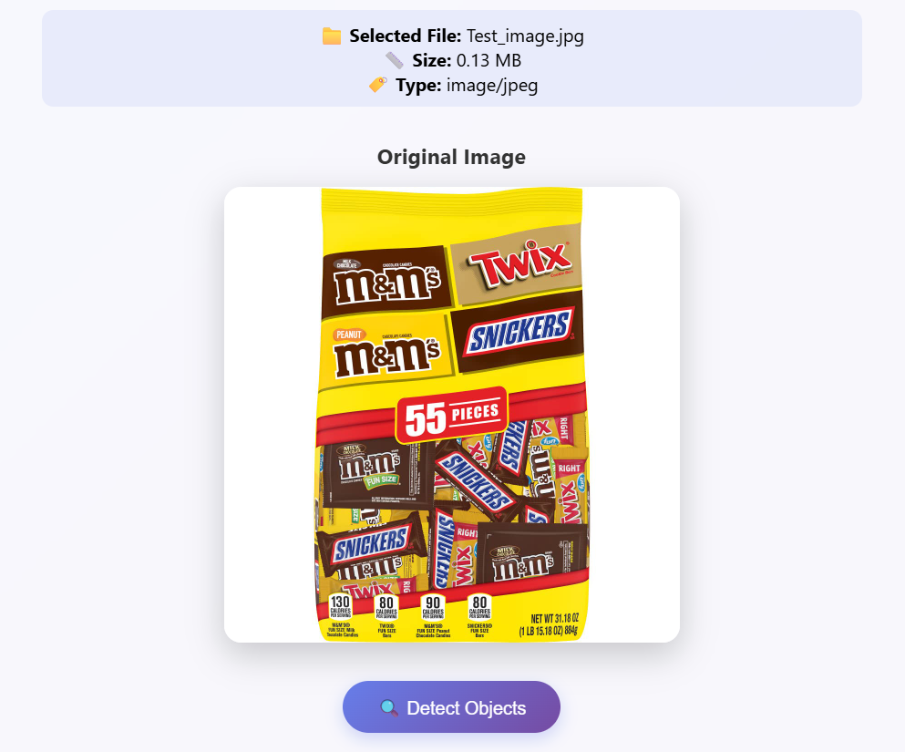

Slide 11
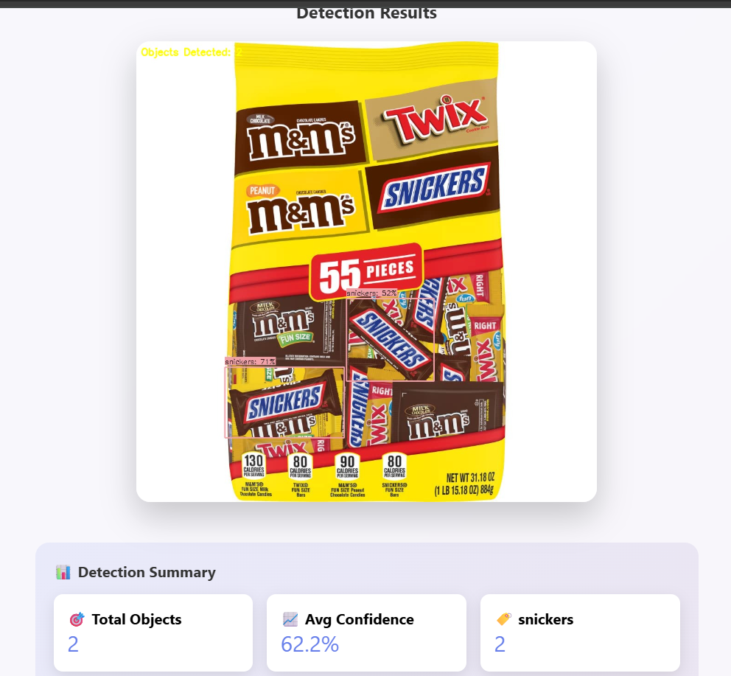

Slide 12
Security & Best Practices
Security Measures
Input Validation
File type restrictions (.jpg, .png, .bmp)
File size limits (16MB max)
Secure filename handling
Container Security
Non-root user in Docker
Minimal base image
No sensitive data in image
Cloud Security
HTTPS by default
IAM access controls
VPC networking options

Slide 13
Best Practices Implemented
Error Handling: Graceful failure modes
Logging: Structured application logs
Monitoring: Health check endpoints
Cleanup: Automatic file deletion
CORS: Cross-origin request support

Slide 14
Limitations & Challenges
Technical Limitations
Cold Start Latency
Model loading takes 30-60 seconds
Affects user experience on first request
Mitigation: Keep minimum instances > 0
Memory Requirements
YOLO11s needs 4-6GB RAM
Higher cloud costs
Limited concurrent processing
Processing Time
Large images (>4K) take longer
Sequential processing only
No batch processing support

Slide 15
Scalability Challenges
1. Model Size: Large model files in container
2. State Management: Model loaded per instance
3. Resource Utilization: GPU not utilized
4. Caching: No result caching implemented
Areas for Improvement - Performance
1. Model Optimization
2. GPU Acceleration
3. Caching Layer
4. Batch Processing
5. Load Balancing: Multiple regions
6. Auto-scaling: Custom metrics-based scaling

Slide 16
Areas for Improvement - Features
1. Enhanced Analytics – Historical Analysis
2. Multi-Format Support – Video Processing, Webcam, batch Processing
3. Progressive Loading: Show results as they're processed
4. Offline Support: Service workers for caching
5. Database Storage: Persistent result storage
6. User Authentication: Multi-tenant support
7. Rate Limiting: API usage controls

Slide 17
Conclusion :
Project Achievements
1. Successfully deployed YOLOV8s web application to GCP
2. Production-ready infrastructure with auto-scaling
3. User-friendly web interface with real-time processing
4. RESTful API for programmatic access
5. Comprehensive error handling and monitoring
6. User Authentication: Multi-tenant support
7. Rate Limiting: API usage controls

Slide 18
Thank you

